Slide 1
Scholarly Communications 101: the four pillars
Erin Gallant - Manager, Digital Scholarship
Imogen Ingram - Digital Literacy Coordinator

Slide 2
Welcome to country
We acknowledge and celebrate the Ngambri and Ngunnawal people on whose traditional lands we meet today, and pay our respects to the elders, past, present and emerging.

Slide 3
Today is a conversation
Scholarly communications?
Brief history of scholarly publications
The four pillars...then & now
Q&A with Erin – ANU Open Research
Digital Scholarship & our SIS learning community

Slide 4
Scholarly Communications?
Notes:
Academics and research communities have always used formal and informal networks to develop ideas, exchange information, build upon and mine data, verify research findings, publish, disseminate through the academic community, and preserve the outputs of that research in a repository.

Slide 5
A (very) brief history....
Notes:
This history is one narrative, it's a single thread amongst the rich and diverse storytelling, oral traditions and millenia of human communication, myth and culture.
The year is 1665. Philosophical transactions – under the editorship of Henry Oldenberg - the first issue of journal of the Royal Society is published.
What was it that Oldenburg and the research community of the time established through the scientific journal?
Registering a new idea and marking it's ownership - original research
Sharing that idea and advancing knowledge in the research field – through handwritten letters, discussions over a pint in the taverns and houses of learning
Certification by credentialed peers as a stamp of quality – verfication and authentication of that new idea
A mechanism to ensure the legacy of the work throughout history – how to
Sound familiar?
Along with the academic journal, the monograph (book) has always played an integral role in knowledge sharing.
The history of monographs dates from works created before the invention of the printing press by Gutenburg in 1440; the Great Library of Alexandria recorded much of the world's knowledge, as did many monasteries and national collections.
The printing press, invented by Gutenberg around 1440, resulted in the ability to print and distribute books in a way that made knowledge more easily accessible.
Discussion, acceptance or debunking of the research within scholarly communities has continued through publication, particularly in written format, through the centuries until now. Journal publication and scholarly monographs have remained the primary, accepted vehicles of scholarly communication.
Now in the digital context?
There's an ever-evolving range of ways to participate the scholarly communication conversation.

Slide 6
The four pillars
Creation
Authentication
Dissemination
Preservation
Notes:
So you can see that these fundamental elements have been embedded from the start of this particular narrative, beginning with Sir Oldfield.
Authoring, publishing, Stewardship, Use
Building on and extending knowledge through scholarship

Slide 7
Another way to think of it is an ecosystem...living knowledge that's built on the ideas and creators that have come before us
Notes:
Academics and research communities have always used formal and informal networks to develop ideas, exchange information, build upon and mine data, verify research findings, publish, disseminate through the academic community, and preserve the outputs of that research in a repository.

Slide 8
Q&A with Erin

Slide 9
Open Research?
Collect, maintain/preserve and disseminate ANU Scholarly Output.
Support & Promote Open Access
Support & Promote ORCID
Support & Promote Research Data Management – Data Commons

Slide 10
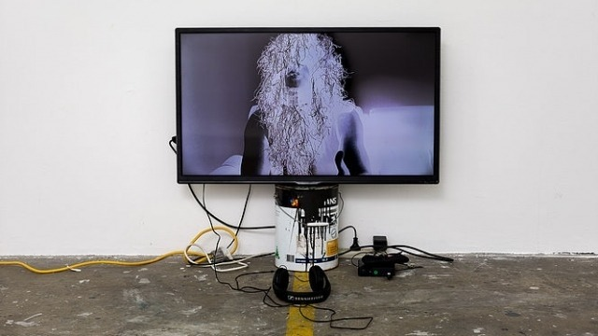
Traditional Vs Non-Traditional Research Outputs
Notes:
A Traditional research output is research published through a conventional publication method a journal article, book, book chapter or conference paper etc
A Non-Traditional Research output (NTRO) is a piece of work or artefact arising from a creator’s research. Non-traditional research output can be creative works that are original, such as visual art works; live performances such as music, play, dance; recorded/rendered works such as film/video. They can also include curated or produced exhibitions and events or research reports produced for an external body.

Slide 11
Questions?

